Slide 1
Grocery Sales Forecasting
Team Members
Rohan Naik
Mayank Gangrade
Chaitanya Joshi

Slide 2
Overview
Grocery sales forecasting is the process of estimating future sales.
Accurate sales forecasts enable companies to make informed business decisions and predict short-term and long-term performance.
The problem becomes more complex as retailers add new locations with unique needs, new products, ever transitioning seasonal tastes, and unpredictable product marketing.
Organization currently rely on subjective forecasting methods with very little data to back them up and very little automation to execute plans.
By using machine learning the retailers can better ensure to please the customers by having just enough of the right products at the right time.

Slide 3
Approach
Analyzing data for anomalies
Data Cleaning to ensure correct values and correlation between the features.
Removing null values and ensuring data quality.
Using the clean and high quality data for cluster analysis.
Based on the clusters identify the features based information and make inference for further analysis.
Implement classification techniques to the clean data and develop predictive models for the forecasting sales.

Slide 4
Data Sources File Descriptions and Data Field Information
train.csv
Training data, which includes the target unit_sales by date, store_nbr, and item_nbr and a unique id to label rows.
The target unit_sales can be integer (e.g., a bag of chips) or float (e.g., 1.5 kg of cheese).
test.csv
Test data, with the date, store_nbr, item_nbr combinations that are to be predicted, along with the on promotion information.
stores.csv
Store metadata, including city, state, type, and cluster.
items.csv
Item metadata, including family, class, and perishable.
transactions.csv
The count of sales transactions for each date, store_nbr combination. Only included for the training data timeframe.

Slide 5
Data Preparation
Checking for missing values
Analyzing Datatypes
Data Explorations and Visualization
One-Hot Encoding (of string type columns)
Memory reduction (so as to keep minimal memory while merging all data frames)

Slide 6
Machine Learning(Unsupervised Learning)
Clustering algorithms on test dataset
Sort data into clusters using Kmeans, DBScan etc
Cross Validate

Slide 7
Machine Learning(Supervised Learning)
Linear regression on train dataset
SVM
Decision tree regressor
Random forest(Bootstrap aggregating)

Slide 8
Model fitting and improve accuracy
Limit tree size
Reduce size of decision trees by removing sections of the tree that provide little power to classify instances
Cost complexity pruning
Reduction in variance to improve information gain

Slide 9
Ensemble Modelling
Combining predictions from several models average out errors and yield better predictions
Tree ensemble modelling is set of classification and regression trees(CART)
Real score is associated with each of the leaves unlike decision trees
Gives richer interpretations that go beyond classification

Slide 10
Gradient Boosting Frameworks
XGBOOST
LGBM
TensorFlow Neural Network

Slide 11
XGBoost
Tree boosting
Optimize objective function(training loss and regularization)
Additive training, Model complexity
Gradient boosted decision trees designed for speed and performance

Slide 12
Light Gradient Boosting Algorithm
Based on decision tree algorithm
Splits the tree leaf wise
Fast
Better accuracy
Low memory usage

Slide 13
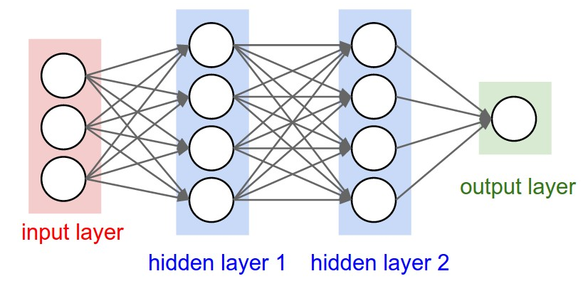
TensorFlow Neural Network
Technically, Tensorflow is used to build this neural network. Before feeding the data into the second layer, batch normalization is used for faster learning(quicker convergent in gradient descent) and Dropout layer is used for regularization to prevent over fitting.

Slide 14
THANK YOU

